Slide 1


Machine learning
NAME – SHIVANGI GUPTA
COURSE - P.G DIPLOMA DATA SCIENCE
ASSISSTANT PROFESSOR
NIHARIKA TEWARI

Slide 2


Content
Introduction to Machine Learning.
Types :-
Supervised Learning
Unsupervised Learning
Reinforcement Learning
Supervised Learning
Regression
Linear Regression
Gradient Descent and cost function
Classification
Logistic Regression
Naïve Bayes Classifier
Gaussian naïve Bayes
Multinomial naïve Bayes
Bernoulli

Slide 3
Introduction
Machine Learning is the field of study that gives computers the capability to learn without being explicitly programmed.
It is one of the most exciting technologies.
As it is evident from the name, it gives the computer that makes it more similar to humans: The ability to learn.
It is actively being used today, perhaps in many more places than one would expect.

Slide 4
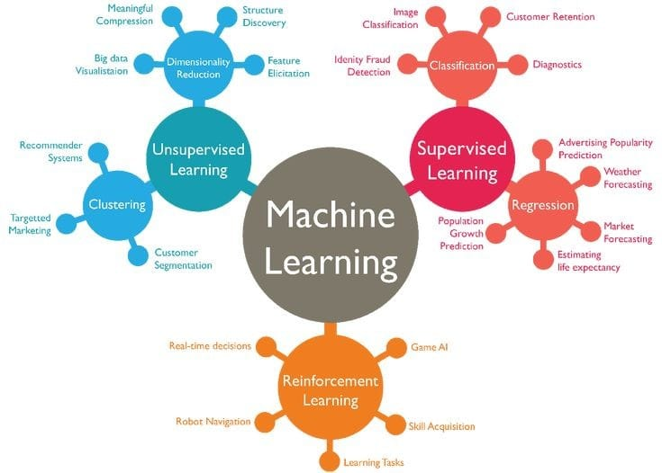

Slide 5
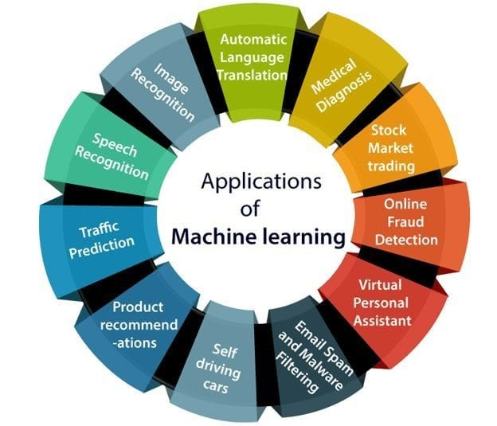

Slide 6
Supervised learning
Supervised learning, as the name indicates, has the presence of a supervisor as a teacher.
Basically supervised learning is when we teach or train the machine using data that is well labelled.
Which means some data is already tagged with the correct answer.
After that, the machine is provided with a new set of examples(data) so that the supervised learning algorithm analyses the training data(set of training examples) and produces a correct outcome from labelled data.
.

Slide 7

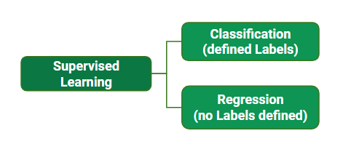
Types of supervised learning
Logistic Regression
Simple Linear
Multiple Linear
Polynomial Regression

Slide 8
REGRESSION ANALYSIS
Regression: It is a Supervised Learning task where output is having continuous value.
It is a set of statistical methods used for the estimation of relationships between a dependent variable and one or more independent variables.
It can be utilized to assess the strength of the relationship between variables and for modeling the future relationship between them.
The goal here is to predict a value as much closer to the actual output value as our model can and then evaluation is done by calculating the error value.
The smaller the error the greater the accuracy of our regression model.

Slide 9
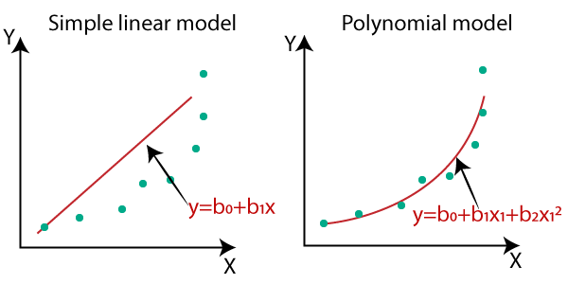
SIMPLE LINEAR REGRESSION
Simple linear regression is a model that assesses the relationship between a dependent variable and an independent variable. The simple linear model is expressed using the following equation:
Y = b0 + b1X
Where:
Y – Dependent variable
X – Independent (explanatory) variable
b0– Intercept
b1 – Slope

Slide 10
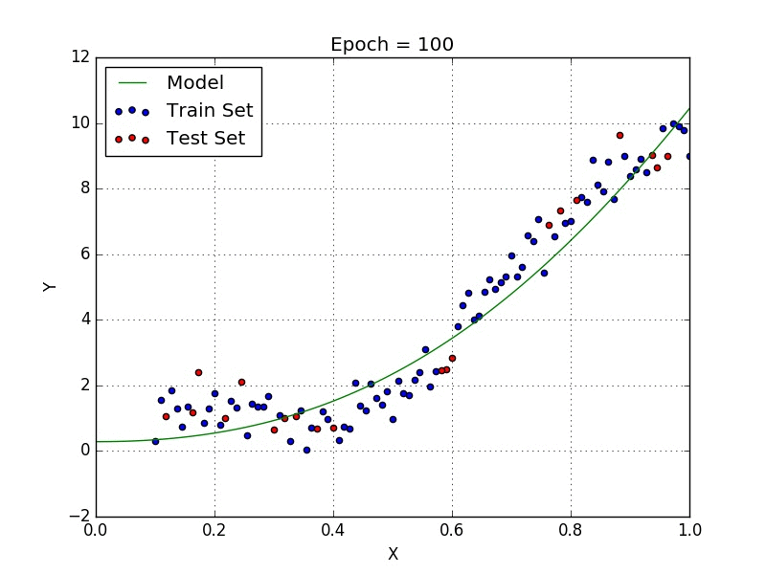
MULTIPLE LINEAR REGRESSION
Multiple linear regression analysis is essentially similar to the simple linear model, with the exception that multiple independent variables are used in the model. The mathematical representation of multiple linear regression is:
Y = a + bX₁ + cX₂ + dX₃ + ϵ
Where:
Y – Dependent variable
X₁, X₂, X₃ – Independent variables
a – Intercept
b, c, d – Slopes
ϵ – Residual (error)

Slide 11
POLYNOMIAL REGRESSION
Polynomial Regression is a regression algorithm that models the relationship between a dependent(y) and independent variable(x) as nth degree polynomial. The Polynomial Regression equation is given below:
y= b₀+b₁x₁+ b₂x₁²+ b₂x₁³+...... b_{n}x₁^{n}
The dataset used in Polynomial regression for training is of
non-linear nature.
It makes use of a linear regression model to fit the complicated
and non-linear functions and datasets

Slide 12
GRADIENT DESCENTW
This is when the Cost function comes into the picture, Cost function calculates the average error (Loss Function) and our goal is to reduce the cost function as much as possible to get the best fit of the line.
Gradient descent is an optimization algorithm which is commonly-used to train machine learning models and neural networks. Training data helps these models learn over time, and the cost function within gradient descent specifically acts as a barometer, gauging its accuracy with each iteration of parameter updates. Until the function is close to or equal to zero, the model will continue to adjust its parameters to yield the smallest possible error. Once machine learning models are optimized for accuracy, they can be powerful tools for artificial intelligence (AI) and computer science applications.

Slide 13
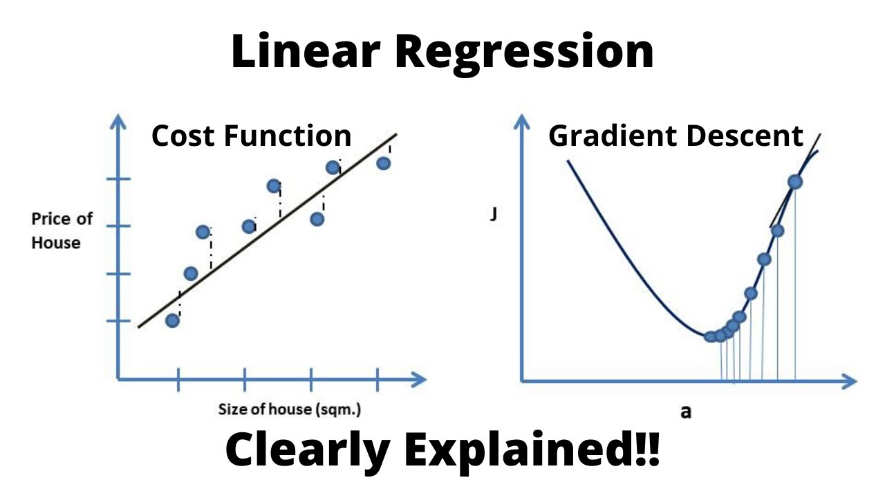
COST FUNCTION
A cost function is a measure of how well a machine learning model performs by quantifying the difference between predicted and actual outputs. Its goal is to be minimized by adjusting the model’s parameters during training. The choice of cost function depends on the type of problem being solved, such as mean squared error for regression problems and cross-entropy for classification problems. The cost function determines the model’s performance.

Slide 14
CLASSIFICATION
Classification is the problem of identifying to which of a set of categories, a new observation belongs, on the basis of a training set of data containing observations and whose categories membership is known.
It is a machine learning task that involves assigning a class label to a given input based on a set of training data.
The goal of classification is to build a model that can accurately predict the class label for new, unseen data.
Classification is the problem of identifying to which of a set of categories (subpopulations), a new observation belongs, on the basis of a training set of data containing observations and whose categories membership is known.
It is a machine learning task that involves assigning a class label to a given input based on a set of training data.
The goal of classification is to build a model that can accurately predict the class label for new, unseen data.

Slide 15
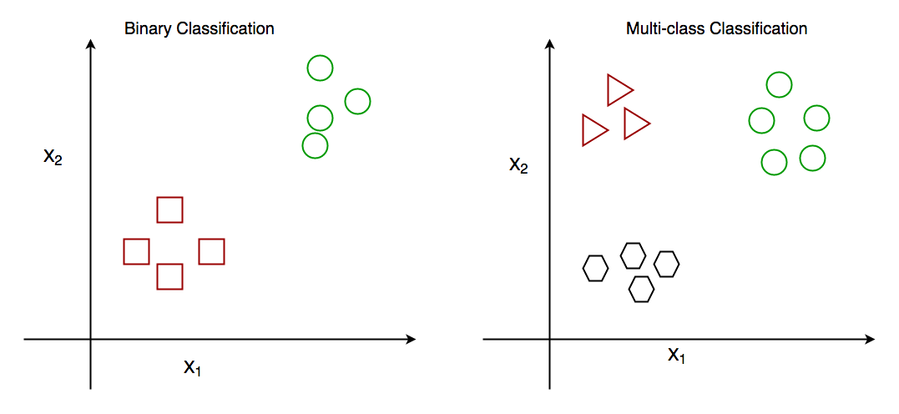
TYPES OF CLASSIFICATION
Binary Classification: When we have to categorize given data into 2 distinct classes. Example – True or False, 0 or 1, Spam or not Spam.
Multiclass Classification: The number of classes is more than 2. For Example – On the basis of data about different species of flowers, we have to determine which specie our observation belongs.

Slide 16
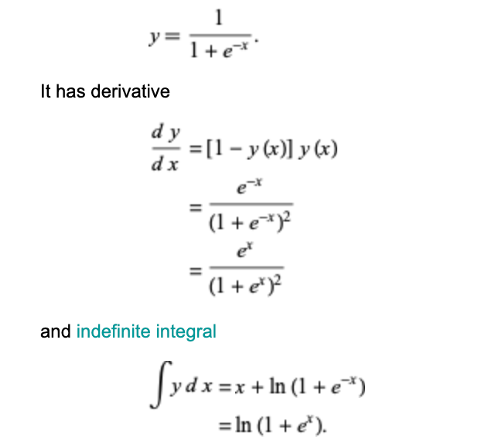
LOGISTIC REGRESSION
Logistic regression is a supervised machine learning algorithm mainly used for classification tasks.
It is used for classification algorithms its name is logistic regression, it’s referred to as regression because it takes the output of the linear regression function as input and uses a sigmoid function to estimate the probability for the given class.
The sigmoid function is a mathematical function having a characteristic “S” — shaped curve, between the range 0 and 1.
The sigmoid function also called the sigmoidal curve.
The mathematical expression for sigmoid:

Slide 17
TYPES OF LOGISTIC REGRESSION
1. Binomial Logistic regression:
Target variable can have only 2 possible types: “0” or “1” which may represent “win” vs “loss”, “pass” vs “fail”, “dead” vs “alive”, etc. in this case sigmoid functions are used.
2. Multinomial Logistic Regression
Target variable can have 3 or more possible types which are not ordered(i.e. types have no quantitative significance) like “disease A” vs “disease B” vs “disease C”. In this case, the softmax function is used in place of the sigmoid function. Softmax function for K classes will be:
3. Ordinal Logistic Regression
It deals with target variables with ordered categories. For example, a test score can be categorized as: “very poor”, “poor”, “good”, or “very good”. Here, each category can be given a score like 0, 1, 2, or 3.

Slide 18

Naïve bayes classifier
Based on Bayes Theorem
It is a probabilistic classifier, which means it predicts on the basis of the probability of an object..
The Naive Bayes classifier is "naive" because it assumes that the presence or absence of a particular feature is independent of the presence or absence of any other feature. This is a simplifying assumption that allows the algorithm to work efficiently and effectively in many cases.
Bayes comes from the Bayes Theorem.

Slide 19
Working
Convert the given dataset into frequency tables.
Generate Likelihood table by finding the probabilities of given features.
Now, use Bayes theorem to calculate the posterior probability.

Slide 20
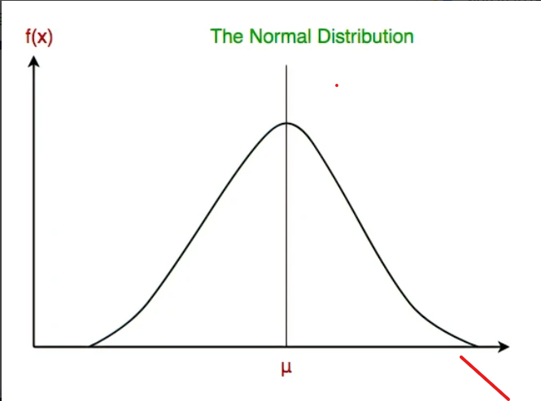

Types of Naïve Bayes Model
1. Gaussian: The Gaussian model assumes that features follow a normal distribution. This means if predictors take continuous values instead of discrete, then the model assumes that these values are sampled from the Gaussian distribution.

Slide 21
2.Multinomial: The Multinomial Naïve Bayes classifier is used when the data is multinomial distributed. It is primarily used for document classification problems, it means a particular document belongs to which category such as Sports, Politics, education, etc. The classifier uses the frequency of words for the predictors.
3.Bernoulli: The Bernoulli classifier works similar to the Multinomial classifier, but the predictor variables are the independent Booleans variables. Such as if a particular word is present or not in a document. This model is also famous for document classification tasks.

Slide 22
Thankyou

